Slide 1
Dry Friction
Dr. Jacob Moore
Associate Professor of Engineering
Penn State Mont Alto

Slide 2
Friction
Friction is the force that prevents objects from sliding relative to one another.
Sometimes this force is useful (as in the brakes on a car)
Sometimes this force is not useful (as in the drag force that slows a plane down)
It is generally broken down into two types of friction.
Dry friction (also called Coulomb Friction) is the friction between two solid objects sliding against one another.
Fluid friction is the friction exerted by fluids on solid objects or other fluids flowing through them.

Slide 3

The Nature of the Dry Friction Force
$$F_{G}$$
A perfectly rough surface
$$F_{push}$$
$$F_{f}$$
Friction Force Pushing Back
(F_{friction})
$$F_{N}$$
$$F_{f}= μ_{s}∗F_{N}$$
$$F_{f}= μ_{k}∗F_{N}$$
A real surface
Force Pushing on Book (F_{push})

Slide 4


Static and Kinetic Friction
$$F_{G}$$
$$F_{push}$$
$$F_{f}$$
$$F_{f}= F_{push}$$
Until the point where…
$$F_{N}$$
Friction Force Pushing Back
(F_{friction})
no relative motion
relative motion
$$F_{f}= μ_{s}∗F_{N}$$
After that point the friction force often drops down to and stays at…
impending motion
$$F_{f}= μ_{k}∗F_{N}$$
Force Pushing on Book (F_{push})

Slide 5
Variables in the Friction Equations
$$F_{f}= μ_{s}∗F_{N}$$
$$F_{f}= μ_{k}∗F_{N}$$
The friction coefficients. Depends on the materials in contact with one another.
The normal force between the two surfaces. The force pressing the two forces together.

Slide 6
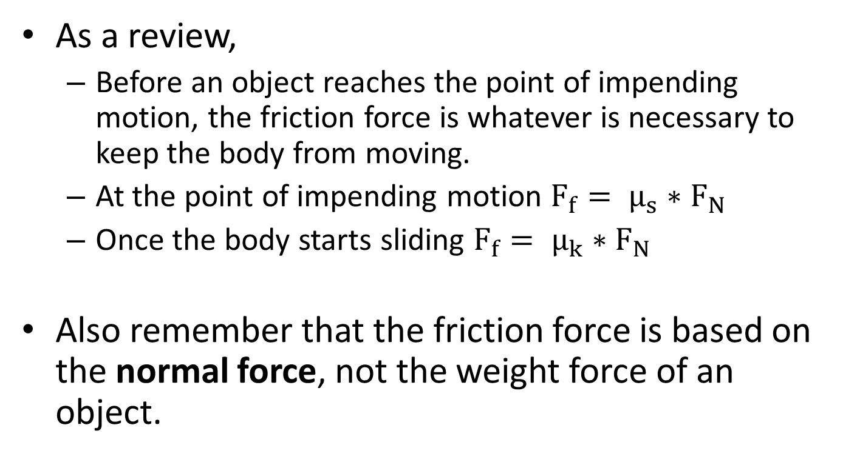
Friction Forces
As a review,
Before an object reaches the point of impending motion, the friction force is whatever is necessary to keep the body from moving.
At the point of impending motion $F_{f}= μ_{s}∗F_{N}$
Once the body starts sliding $F_{f}= μ_{k}∗F_{N}$
Also remember that the friction force is based on the normal force, not the weight force of an object.

Slide 7
Thanks for Watching
See other engineering mechanics videos and access the full tool at…

Slide 8
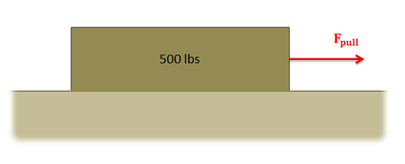
Friction Worked Example
A 500 lb box is sitting on concrete floor. If the static coefficient of friction is .7 and the kinetic coefficient of friction is .6:
What is the friction force if the pulling force is 150 lbs?
What pulling force would be required to get the box moving?
What is the minimum force required to keep the box moving once it has started moving?

Slide 9
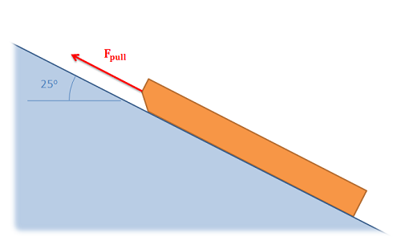
Friction Worked Example
A 30 lb sled is being pulled up an icy incline of 25 degrees. If the static coefficient of friction between the ice and the sled is .4 and the kinetic coefficient of friction is .3, what is the required pulling force needed to keep the sled moving at a constant rate?

Slide 10
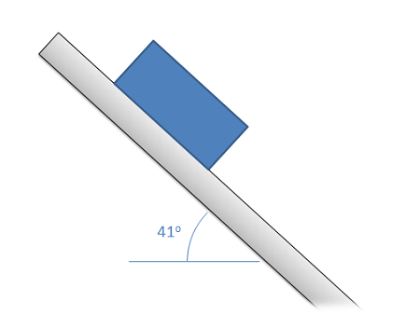
Friction Worked Example
A plastic box is sitting on a steel beam. One end of the steel beam is slowly raised, increasing the angle of the surface until the box begins to slip. If the box begins to slip when the beam is at an angle of 41 degrees, what is the static coefficient of friction between the steel beam and the plastic box?

Slide 11
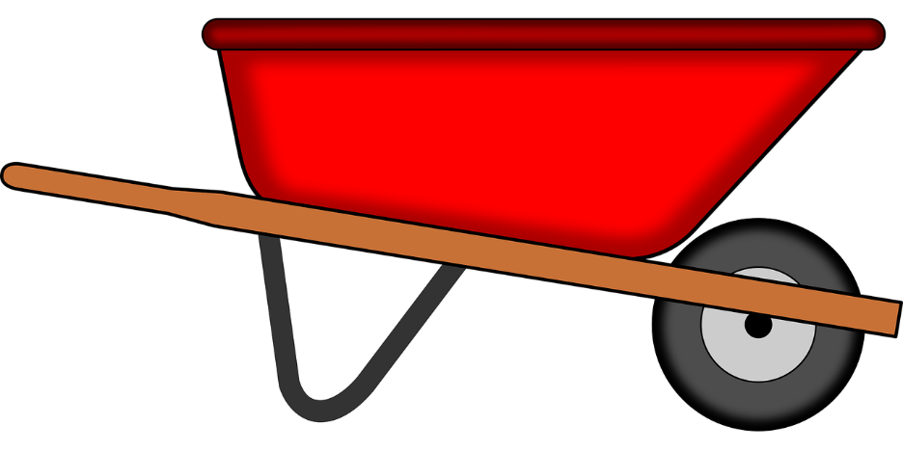
Friction Worked Example
A 60 kg wheelbarrow with the dimensions shown below is subjected to a pulling force. If there is assumed to be no friction at the wheel at B, and the static coefficient of friction at A is assumed to be .4, what is the expected pulling force needed to get the wheelbarrow moving?
80 cm
60cm
F_{pull}
G
70 cm
80 cm
A
B

Slide 12
Friction Worked Example
A cabinet with a weight of 30 lbs is sitting on a 15º incline as shown the right. The cabinet has a pair of rubber feet at the front (A), and a pair of frictionless wheels at the back (B). What is the minimum value for the static coefficient of friction for the rubber feet at the front to ensure the cabinet does not roll down the incline?
G
18 in
A
B
10 in
8 in

